Slide 1
Chapter 1 Computer Fundamentals

Slide 2
COMPUTER
An electronic device
Processes input to set of instructions & gives desired output.
It is versatile – they do lot of different tasks.
Eg.: Storing data, weather forecasting, booking airline, railway or movie tickets.

Slide 3
Data & Information
Data: Term used for raw facts and figures.
Information: Data represented in useful and meaningful form.
Raw material that is processed to give meaning, ordered or structured information.

Slide 4
Functional components of computer
Computer is a combination of hardware and software.
Hardware are physical components like motherboard, memory devices, monitor, keyboard etc.
Software is the set of programs or instructions.
Every task given to a computer follows an Input- Process- Output Cycle (IPO cycle).
It needs certain input, processes that input and produces the desired output.

Slide 5
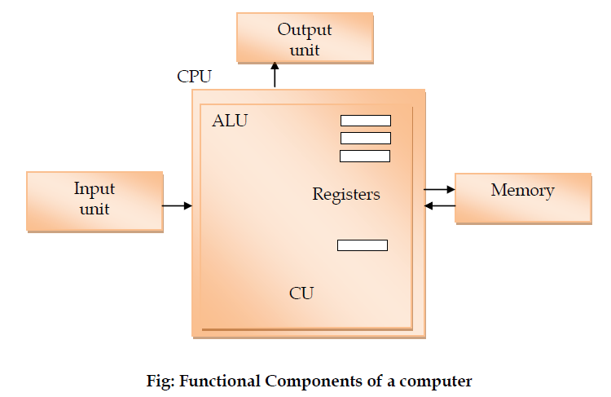
Functional components of computer

Slide 6
Input Unit
The input unit consists of input devices that are attached to the computer.
These devices take input and convert it into binary language that the computer understands.
Some of the common input devices are keyboard, mouse, joystick, scanner etc.

Slide 7
Central Processing Unit (CPU)
The CPU is called the brain of the computer because it is the control centre of the computer.
As the CPU is located on a small chip, it is also called the microprocessor.
It first fetches instructions from memory and then interprets them so as to know what is to be done.
If required, data is fetched from memory or input device.

Slide 8
Central Processing Unit (CPU)
The CPU is called the brain of the computer because it is the control centre of the computer.
Thereafter CPU executes or performs the required computation and then either stores the output or displays on the output device.
The CPU has three main components which are responsible for different functions
Arithmetic Logic Unit (ALU) , Control Unit (CU) and Memory registers.

Slide 9
Arithmetic and Logic Unit (ALU)
The ALU performs mathematical calculations and takes logical decisions.
Arithmetic calculations include addition, subtraction, multiplication and division.
Logical decisions involve comparison of two data items

Slide 10
Control Unit
The Control unit coordinates and controls the data flow in and out of CPU and also controls all the operations of ALU, memory registers and also input/output units.
It decodes the fetched instruction, interprets (understands) it and sends control signals to input/output devices until the required operation is done.

Slide 11
Memory Registers
A register is a temporary unit of memory in the CPU. These receive data/information and then this data/information is held in them as per the requirement. Registers can be of different sizes(16 bit , 32 bit , 64 bit and so on).
Each register inside the CPU has a specific function like storing data, storing an instruction, storing address.
Accumulator (ACC) is the main register in the ALU and contains one of the operands of an operation to be performed.

Slide 12
Memory
Memory attached to the CPU is used for storage of data and instructions and is called internal memory.
During processing, it is the internal memory that holds the data.
The internal memory is divided into many storage locations.
Each memory location is of the same size and has an address.
With the help of the address, the computer can find any data easily

Slide 13
Memory
This memory is also called Random Access memory (RAM).
Primary memory is volatile in nature. That means when the power is switched off, the data stored in this memory is permanently erased.
That is why secondary memory is needed to store data and information permanently for later use.

Slide 14
Output Unit
The output unit consists of output devices that are attached with the computer.
It converts the binary data coming from CPU to human understandable from.
The common output devices are monitor, printer, plotter etc.

